Slide 1

St Osmund’s Catholic Primary School
Welcome to Year 1
Class teacher: Mr Veale
Teaching Assistants: Mrs Gellard and Mrs Coffey

Slide 2
Curriculum Evening – Year One
Curriculum
Discrete and cross curricular teaching
Some themes span a whole term and others half termly

Slide 3
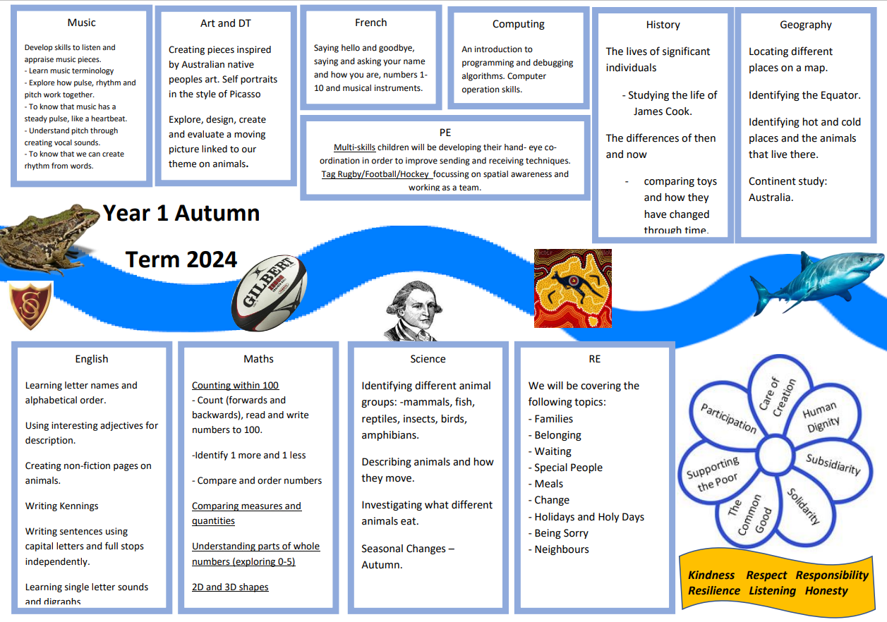
Curriculum Evening – Year One

Slide 4
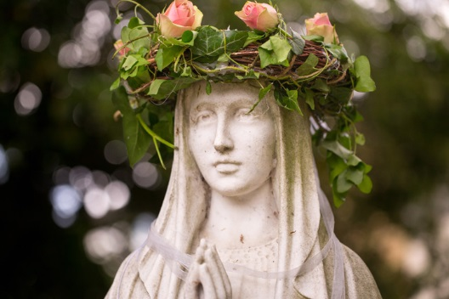
Curriculum Evening – Year One
R.E.
Follow ‘Come & See’ scheme of work -involves class discussion, writing, art
Prayers
Collective worship within class
Study other World Faiths – World Faith Mix-up Days
10% of curriculum time

Slide 5
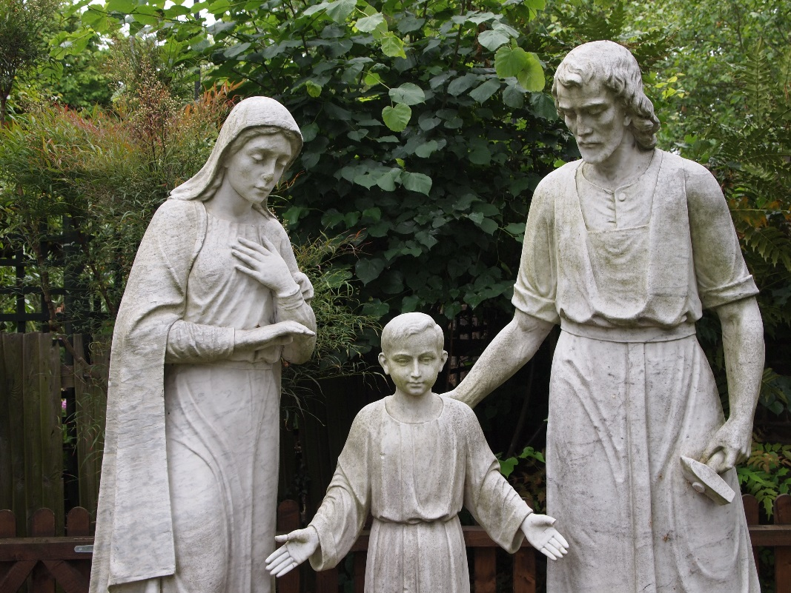
Curriculum Evening – Year One
Mass
School masses will be happening in school and in church. Mass is a special time and it’s important we all treat it as such.

Slide 6
Curriculum Evening – Year One
Reading
We hear children read as part of lessons, 1:1, small groups and during phonics activities.
Reading lists – next slide
School library and class library – birthday book contribution
Read daily and comment in reading records – this is essential
10 minutes are the minimum required to build reading stamina. Very important for Yr 2 SATs.
Books changed on Monday and Thursday.

Slide 7


Slide 8


Slide 9

Curriculum Evening – Year One
Writing in KS1
Correct pencil grip
Looking for use of sounds when writing
Finger spaces
Correct letter formation
Capital letters and full stops
Neat presentation
SPaG
Different genres

Slide 10
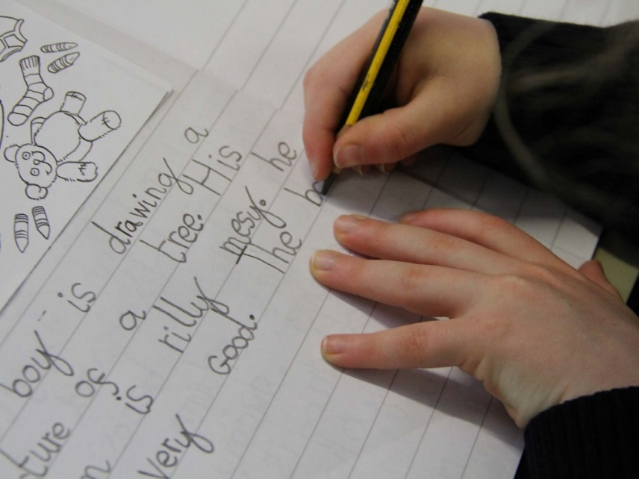
Curriculum Evening – Year One
Handwriting
Precursive Script, letter joins by end of Yr 1
Letter spacing and formation linked to phonics
High expectations & pride in their work. On the line, ascenders and decenders.

Slide 11

Curriculum Evening – Year One
Mathematics
Mathematical skills:
reasoning and critical thinking
Application to real life situations

Slide 12
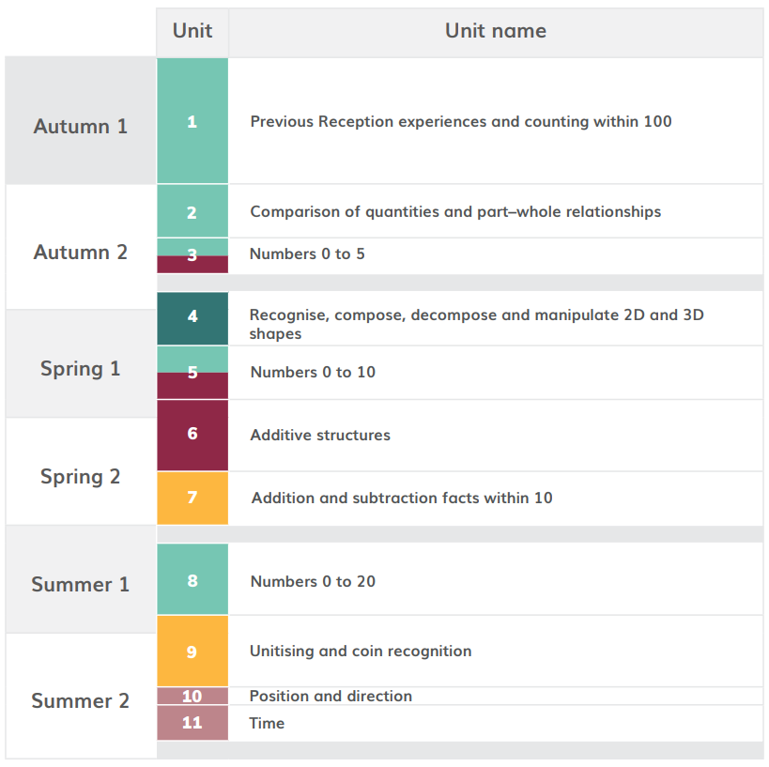

Slide 13
Curriculum Evening – Year One
Homework - Let your child have a go at completing the work independently but support them if necessary.
Spellings are set on Friday and tested on following Friday – Spelling Frame
Maths homework, set Wednesday and returned on Friday (30 minutes)
Reading/handwriting homework, set Friday and returned on Tuesday (30 minutes)

Slide 14
Curriculum Evening – Year One
Behaviour & Discipline
3 simple rules- Be ready, be respectful, believe
Golden Values
Star of the week
Smiley faces
Dojo points
Encouragement & high expectations

Slide 15
Ready  Respect  Believe
Ready
Be on time
Correct, smart uniform
Correct equipment
Books and homework returned on time
Positive attitude to learning
Well rested
Well prepared
Hydrated
Respect
Respectful of staff and peers
Respectful of environment
Speak and listen with respect
Respectful of resources/belongings
Walking sensibly
Following rules and instructions
Respect for ideas, thoughts and opinions of others.
Believe
Growing in faith
Believing in yourself
Being engaged and enthusiastic
Reflecting on learning
Recognising strength
Resilience
Learning from mistakes
Growth mindset
Be Ready, Be Respectful and Believe

Slide 16
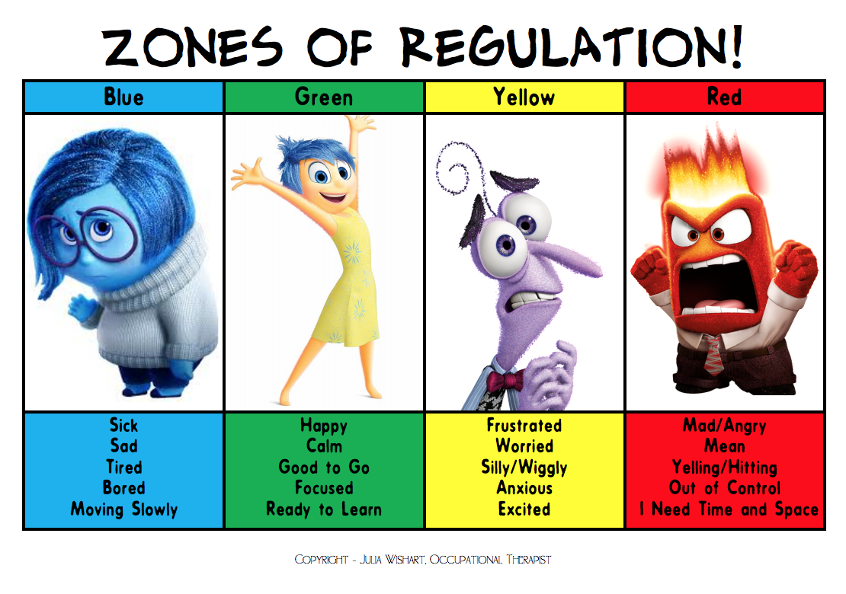
Curriculum Evening – Year One
Zones of Regulation – whole school approach
The concept of The Zones of Regulation is to teach students to self-regulate their sensory needs as well as their emotions and impulses in order to meet the demands of the environment and be successful academically and socially. (Leah M. Kuypers).
We want all our pupils to find their optimum state to learn and to be able to move from one zone to another independently and cope with challenging situations when faced with them.

Slide 17
Curriculum Evening – Year One
Lateness, absence, sickness & going home
School drop off is between 8:45am-8:55am and pick up is at 3:20pm
For any contagious illness, keep your child at home until symptoms have gone e.g. cold, flu, chickenpox
Who collects your child?

Slide 18
Curriculum Evening – Year One
Sport
NSS teaches P.E on Monday and Thursday afternoon –
The children will come into school in their school uniform and come home in their PE kit.
Please label items
Daily Mile

Slide 19
Curriculum Evening – Year One
Uniform
Smart & correct uniform at all times
All items clearly labelled with your child’s name
Socks – grey, white or navy
Navy or white hair accessories
Correct P.E kit

Slide 20
Curriculum Evening– Year One
Educational visits
Consent forms
Parent helpers
- parent readers greatly appreciated
- 1:6 ratio required for school trips. Adults selected at random.
- adult responsibilities

Slide 21
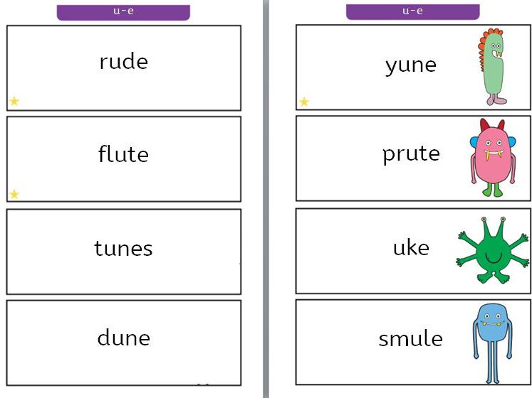
Curriculum Evening– Year One
Phonics Screening
June 2023
40 words comprised of 74 sounds
– mix of real and alien
CVC, CVCC, CVCC, CCCVC & CCCVCC
Pass = 32+ correctly decoded words
Retested in Year 2
Children should sight read 60 words a minute by the end of Year 1.

Slide 22
Curriculum Evening – Year One
Questions?

