Slide 1

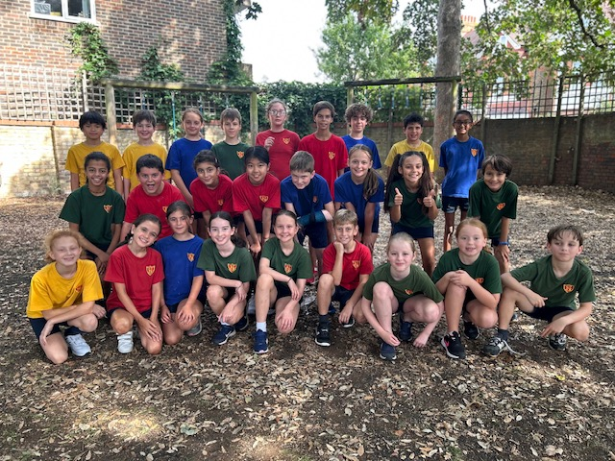
St Osmund’s Catholic Primary School
Welcome to Year 6
Class teacher: Miss George
Teaching Assistant: Mrs White & Mrs Robertson Cole

Slide 2
Curriculum Evening – Year Six
Curriculum
Some topics span a whole term and others half termly
Cross curricular where possible

Slide 3
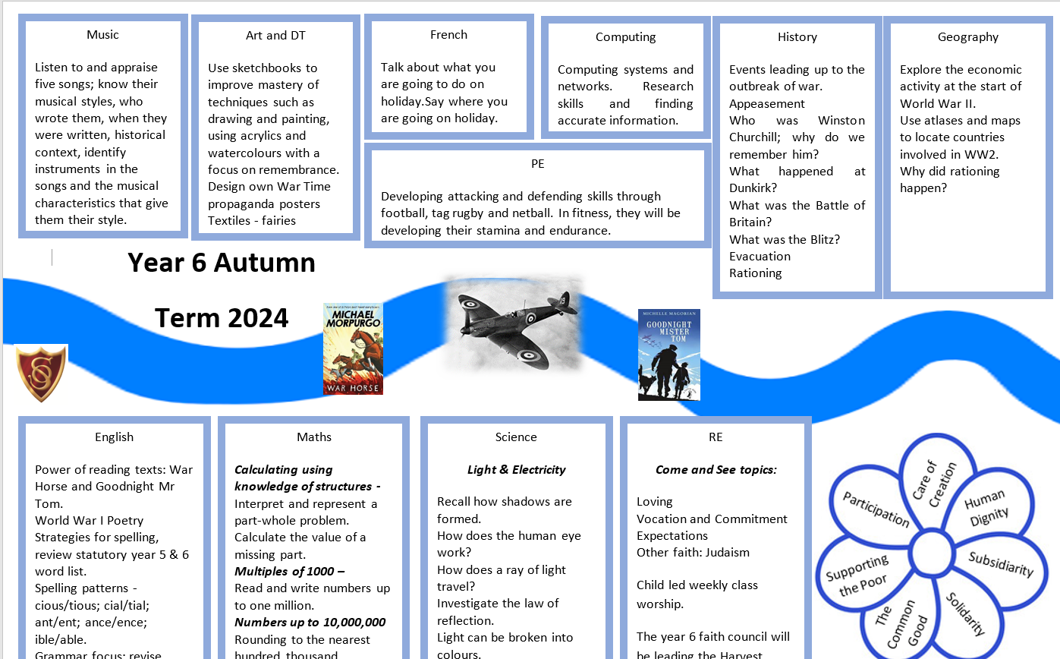
Curriculum Evening – Year Six

Slide 4
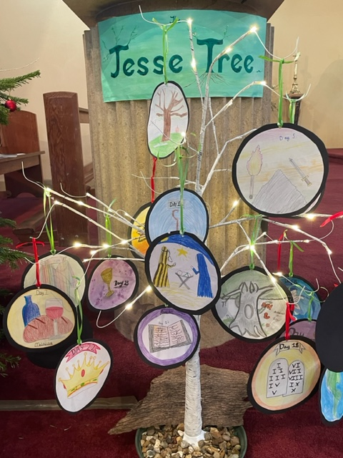
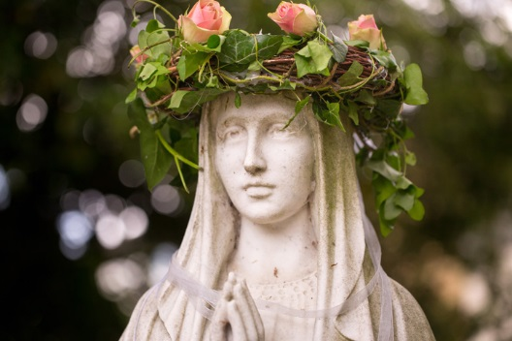
Curriculum Evening – Year Six
R.E.
Follow ‘Come & See’ scheme of work -involves class discussion, writing, art
Prayers
Prepare and deliver collective worship within class
Study other World Faiths – Judaism and
World Faith Mix-up Days
10% of curriculum time

Slide 5
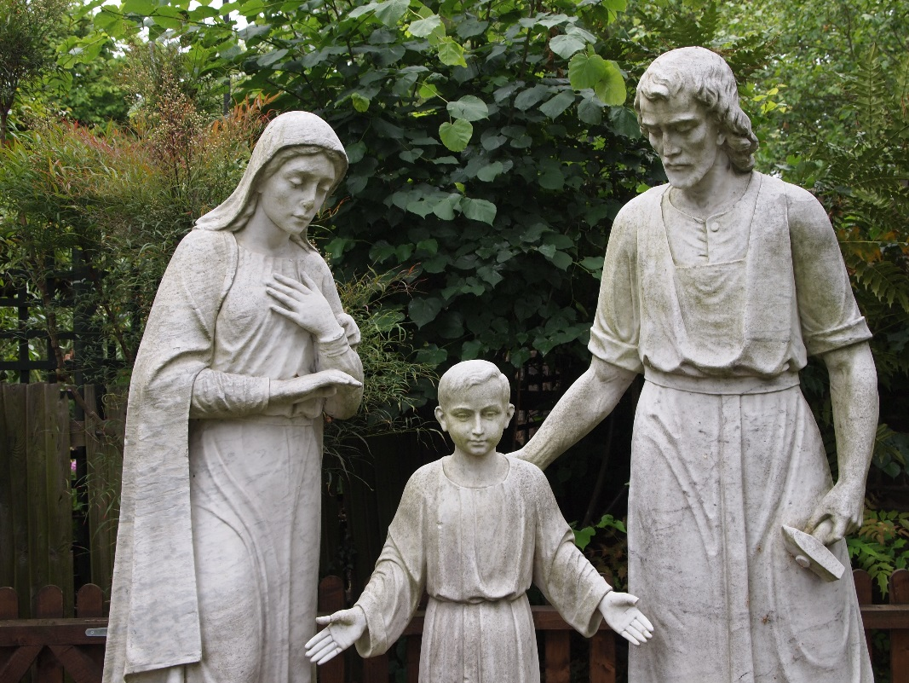
Curriculum Evening – Year Six
School masses – you are very welcome to attend
House Feast Days – celebrated with house captains leading house group liturgies
Monsignor Cronin is invited to deliver
assemblies and visit year 6.

Slide 6
Curriculum Evening – Year Six
Reading
We hear children read as part of guided reading, individually and as an integral part of lessons. Foccus on exposure to a rich vocabulary
Reading lists – recommended texts (school website – Parents, Homework & Curriculum, follow link for year 6), breadth of genres
School library & class library
Read daily – please sign the diary at least once a week
Virtual library on the website

Slide 7
Curriculum Evening – Year Six
Spelling
Spellings are set on Friday – these will include a spelling pattern/rule and some words from the year 5/6 statutory spelling list.
Review and test on Friday.
Grammar Spelling and Punctuation journal needs to go home daily with evidence of daily spelling work. (Colour spelling, pyramid spelling, drawings, segmenting, word families)

Slide 8
Curriculum Evening – Year Six
Writing in KS2
Opportunities to write for a range of purposes – short stories, spy thrillers, adventure, historical stories, WWI poetry, autobiography/biography, journalistic writing, non-chronological reports, other poetry (Ted Hughes).
Features of different text types
Breadth of vocabulary
Knowledge of sentence structure and types (Alan Peat)
Identification of audience and purpose
SPaG
Presentation – cursive handwriting

Slide 9
Curriculum Evening – Year Six
Writing in KS2 – WTS
The pupil can:
• write for a range of purposes
• use paragraphs to organise ideas
• in narratives, describe settings and characters
• in non-narrative writing, use simple devices to structure the writing and support the reader (e.g. headings, sub-headings, bullet points)
• use capital letters, full stops, question marks, commas for lists and apostrophes for contraction mostly correctly
• spell correctly most words from the year 3 / year 4 spelling list, and some words from the year 5 / year 6 spelling list
• write legibly.

Slide 10
Curriculum Evening – Year Six
Writing in KS2 – EXS
The pupil can:
•write effectively for a range of purposes and audiences, selecting language that shows good awareness of the reader (e.g. the use of the first person in a diary; direct address in instructions and persuasive writing)
• in narratives, describe settings, characters and atmosphere
• integrate dialogue in narratives to convey character and advance the action
• select vocabulary and grammatical structures that reflect what the writing requires, doing this mostly appropriately (e.g. using contracted forms in dialogues in narrative; using passive verbs to affect how information is presented; using modal verbs to suggest degrees of possibility)
• use a range of devices to build cohesion (e.g. conjunctions, adverbials of time and place, pronouns, synonyms) within and across paragraphs
• use verb tenses consistently and correctly throughout their writing
• use the range of punctuation taught at key stage 2 mostly correctly (e.g. inverted commas and other punctuation to indicate direct speech)
• spell correctly most words from the year 5 / year 6 spelling list, and use a dictionary to check the spelling of uncommon or more ambitious vocabulary
• maintain legibility in joined handwriting when writing at speed.

Slide 11
Curriculum Evening – Year Six
Writing in KS2 – GDS
The pupil can:
• write effectively for a range of purposes and audiences, selecting the appropriate form and drawing independently on what they have read as models for their own writing (e.g. literary language, characterisation, structure)
• distinguish between the language of speech and writing and choose the appropriate register
• exercise an assured and conscious control over levels of formality, particularly through manipulating grammar and vocabulary to achieve this
• use the range of punctuation taught at key stage 2 correctly (e.g. semi-colons, dashes, colons, hyphens) and, when necessary, use such punctuation precisely to enhance meaning and avoid ambiguity.
• spell correctly most words from the year 5 / year 6 spelling list, and use a dictionary to check the spelling of uncommon or more ambitious vocabulary
• maintain legibility in joined handwriting when writing at speed.

Slide 12
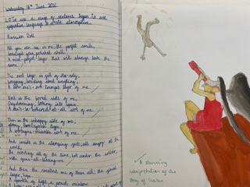
Curriculum Evening – Year Six
Handwriting
Cursive Script
Letter spacing
High expectations & pride in their work

Slide 13

Curriculum Evening – Year Six
Mathematics
Real life examples.
Topics covered this year: Calculating using knowledge of structures, Multiples of 1,000, Numbers upto 10,000,000, Draw, compose and decompose shapes, Multiplication and division, Area, perimeter, position and direction, Fractions and Percentages, Statistics, Ratio and Proportion, Calculating using knowledge of structures, Solving problems with two unknowns, Order of operations and Mean average.
Children need to be fluent in fundamentals of maths, be able to reason mathematically following a line of enquiry using mathematical language and solve problems by applying their mathematics to a variety of problems
Curriculum Coverage – can be found on the website under Curriculum, Curriculum overviews
Homework – focus on mental mathematics (Schofield and Sims + Consolidation) and consolidation of work in class and in the Spring term SATs papers

Slide 14
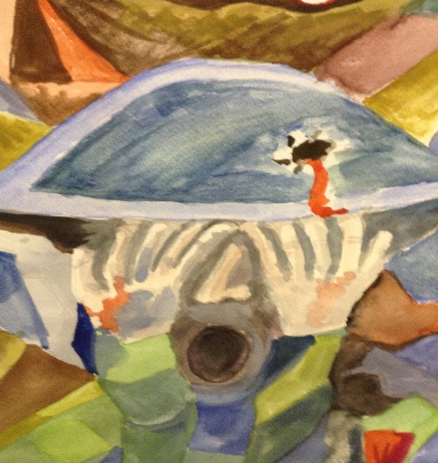
Curriculum Evening – Year Six
Homework
Grammar task or comprehension (Schofield and Sims book, set Monday and due on Wednesday – 30 minutes)
Spellings set on Monday
Mathematics homework, set Wednesday and returned on Friday (45 minutes)
Topic/English homework handed out on Friday and returned on Tuesday (60 minutes)

Slide 15
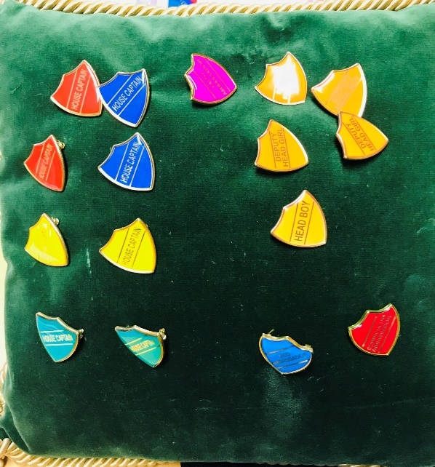
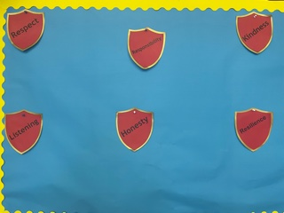
Curriculum Evening – Year Six
Behaviour & Discipline
Golden Values
House points
Ready - Respect - Believe
Encouragement & high expectations –
developing an understanding
of their responsibilities as role models
for the other pupils in our school.

Slide 16
Ready  Respect  Believe
Ready
Be on time
Correct, smart uniform
Correct equipment
Positive attitude to learning
Well rested
Well prepared
Hydrated
Respect
Respectful of staff and peers
Respectful of environment
Speak and listen with respect
Respectful of resources/belongings
Walking sensibly
Following rules and instructions
Respect for ideas, thoughts and opinions of others.
Believe
Growing in faith
Believing in yourself
Being engaged and enthusiastic
Reflecting on learning
Recognising strength
Resilience
Learning from mistakes
Growth mindset
Be Ready, Be Respectful and Believe

Slide 17
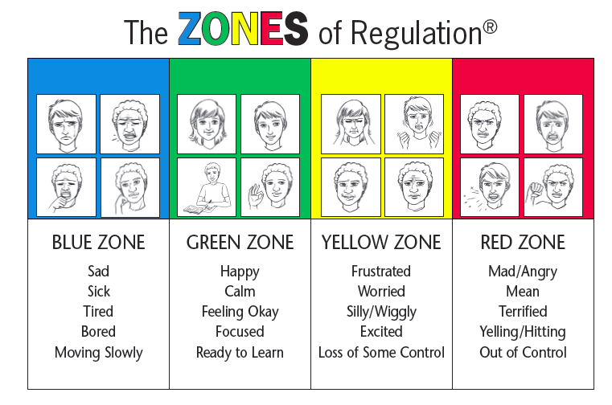
Curriculum Evening – Year Six
Zones of Regulation – whole school approach
The concept of The Zones of Regulation is to teach students to self-regulate their sensory needs as well as their emotions and impulses in order to meet the demands of the environment and be successful academically and socially. (Leah M. Kuypers).
We want all our pupils to find their optimum state to learn and to be able to move from one zone to another independently and cope with challenging situations when faced with them.

Slide 18
Curriculum Evening – Year Six
Lateness, absence, sickness & going home
School drop off is between 8:45 – 8:55 am (pedestrian gate) and pick up will be at 3:30 pm (vehicle gate)
Who collects your child?
Permission to walk home alone
Mobile phones – complete form and return to the school office

Slide 19
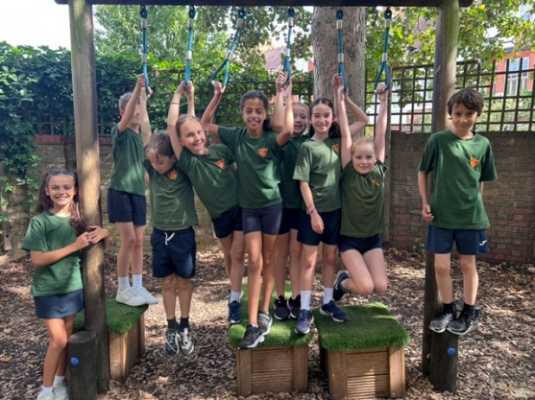
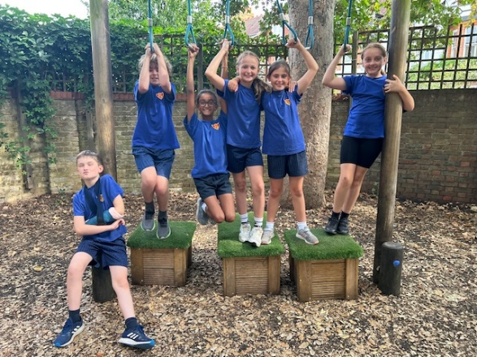
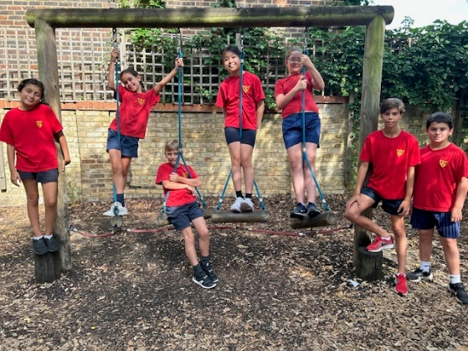
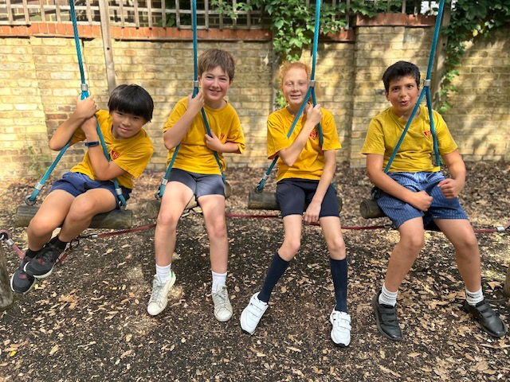
Curriculum Evening – Year Six
Sport
NSSport teach P.E on Wednesday morning this term – wear PE kit, hoodies allowed
Please label items
Leagues and tournaments
Daily Mile

Slide 20
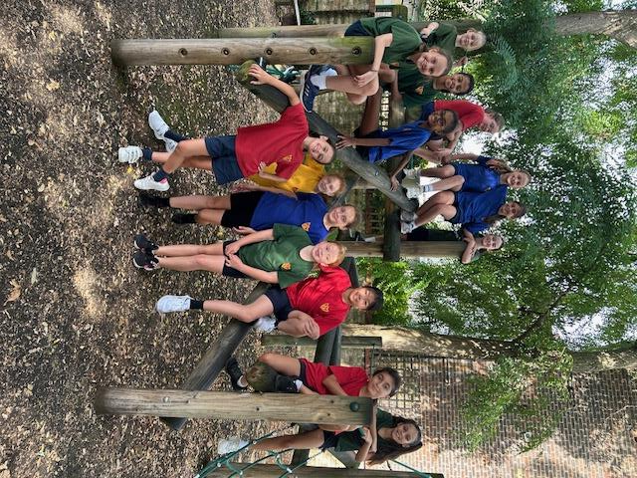
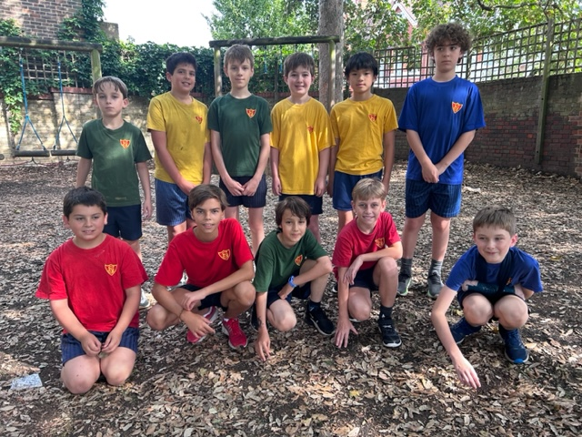
Curriculum Evening – Year Six
Uniform
Smart & correct uniform at all times
All items clearly labelled with your child’s name
Socks – grey, white or navy
Navy or white hair accessories
Correct P.E kit

Slide 21
Curriculum Evening– Year Six
Educational visits
Autumn trips – Normandy, Air Raid Shelter at St Leonard’s Court, RAF Museum and Imperial War Museum
Spring – Junior Citizenship at Holly Lodge & Cycling Proficiency
Consent forms to be completed
Parent helpers always welcome and needed

Slide 22
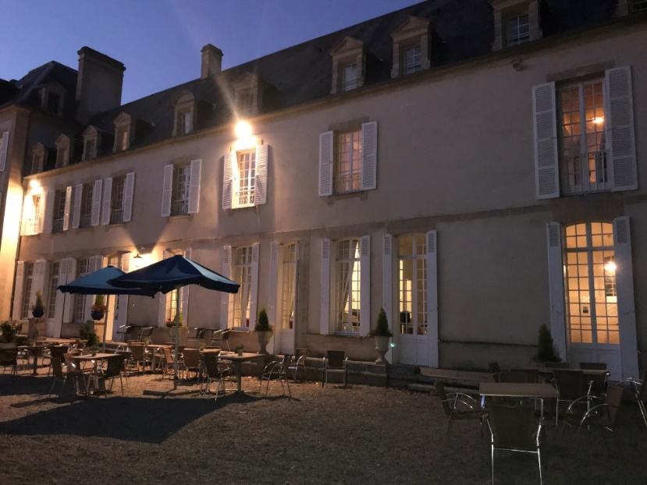
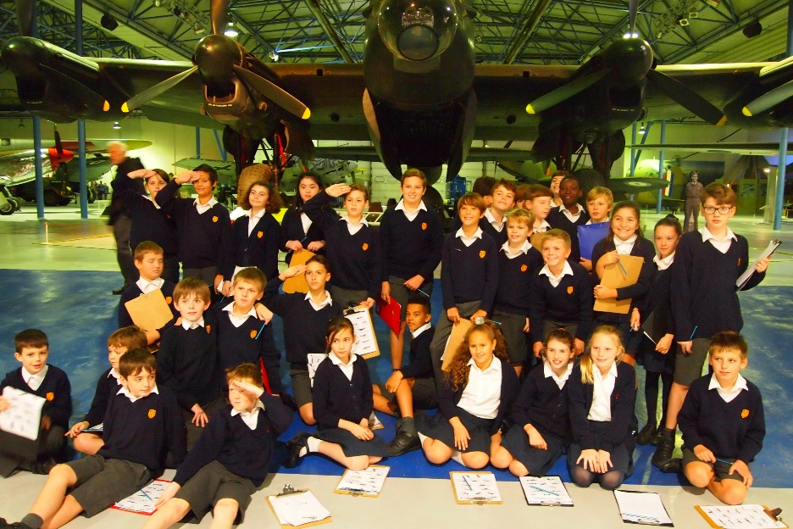
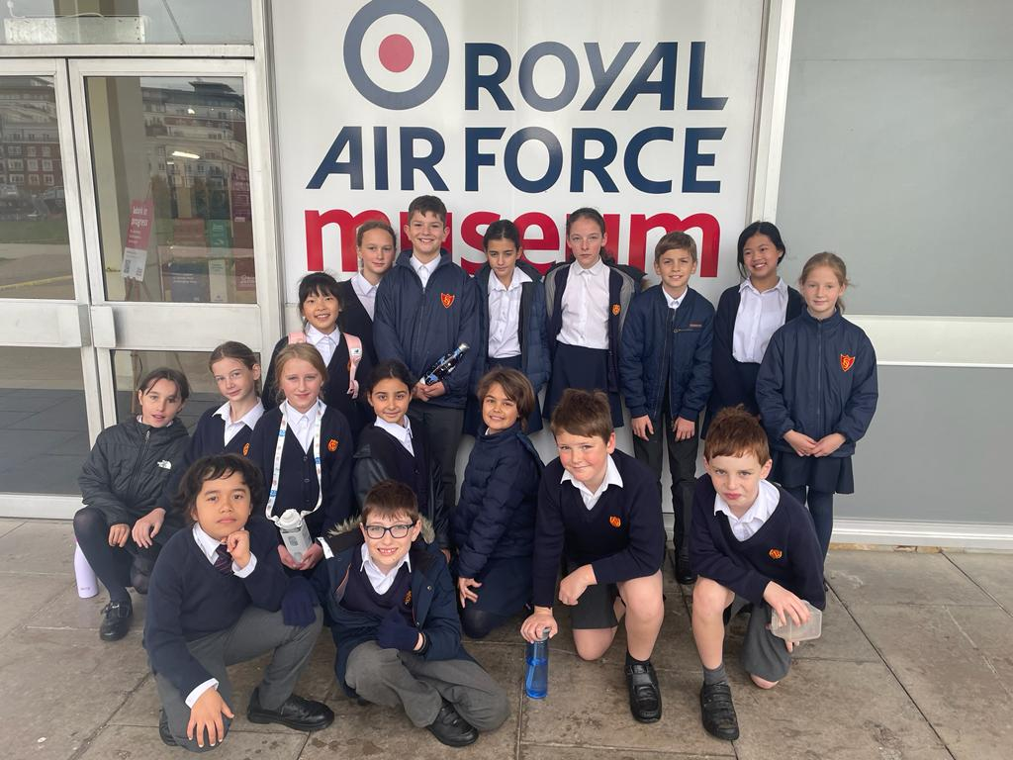
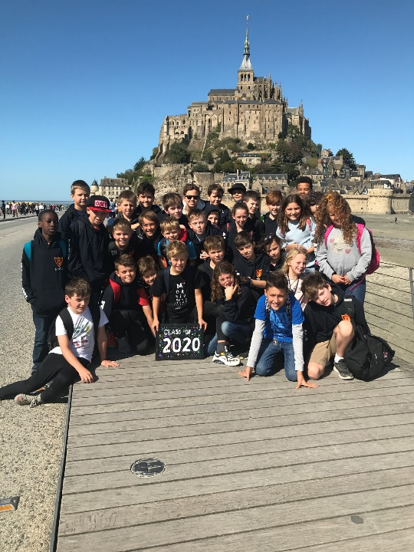
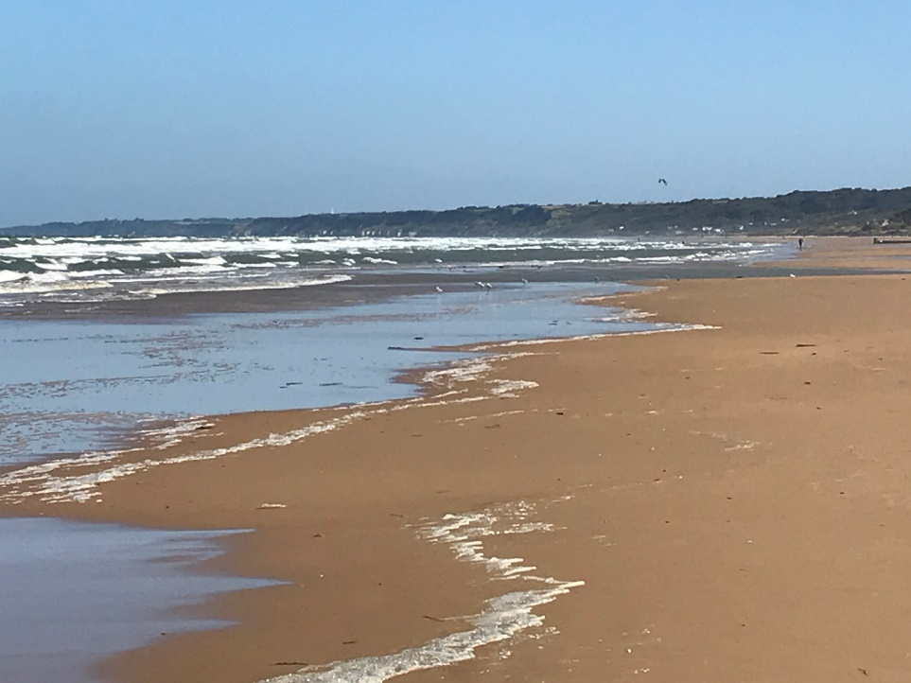
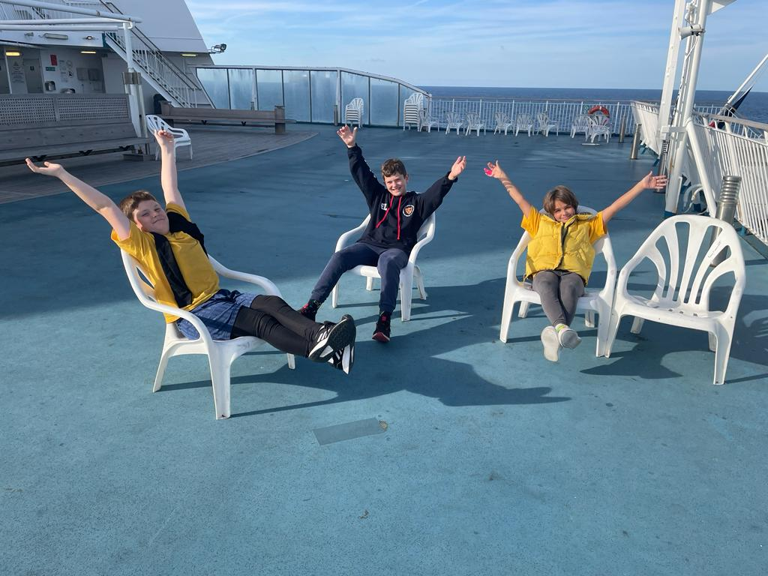
Curriculum Evening – Year Six

Slide 23
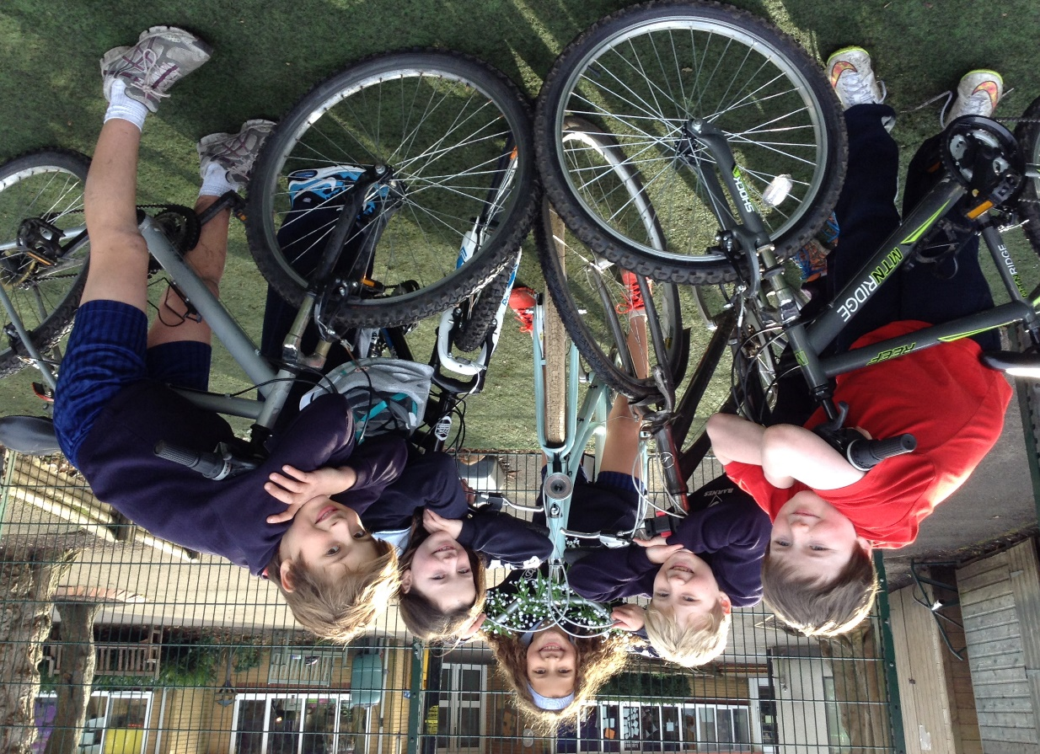
Curriculum Evening – Year Six
Richmond Bikeability Level 2 cycle training TBC

Slide 24
SATs
^{13th -16th May}
Sports and breakfast each morning
Reading Paper
Mathematics – Paper 1 Arithmetic, Paper 2 Reasoning & Paper 3 Reasoning
SPaG – Paper 1 & Paper 2 Spelling
Scaled scores are awarded for these tests. This scale ranges from 80-120 with 100 or more being the EXS. The raw score converts to a scaled score.
Writing is teacher assessed
(WTS, EXS or GDS)

Slide 25

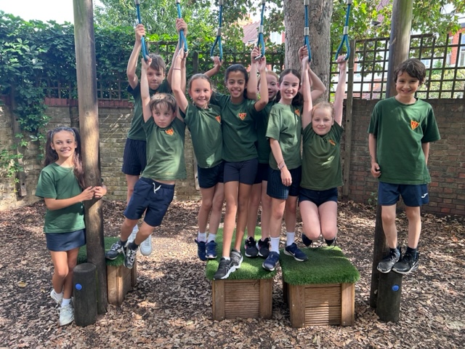
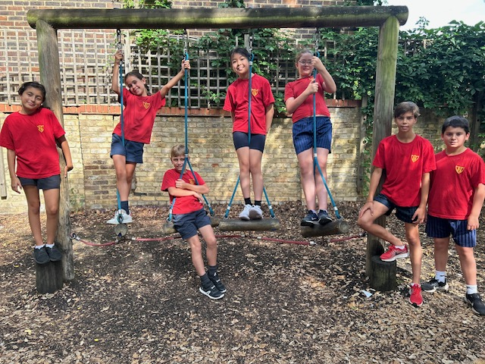
Curriculum Evening – Year Six
Communication
Appointments – via the school office

